Slide 1
Role of RAS in the
Agricultural Innovation System
Rasheed Sulaiman V
Centre for Research on Innovation & Science Policy
Hyderabad, India

Slide 2
Context
Increasing realization that RAS should develop new capacities to deal with:
a. the new challenges in agriculture &
b. new opportunities arising from pluralism
Also revisit some of the paradigms that shaped its historical evolution
-Reinvent it based on new insights on the process of innovation

Slide 3
From Linear Paradigm to….
Research
Extension
Farmers

Slide 4
Improvements to the Linear Paradigm
ICTs
Gender
Research
Extension
Farmers
Markets
Participation
Education

Slide 5
New Challenges
Pluralism
ICTs
Gender
Research
Extension
Farmers
Participation
Markets
Education
Need for a better paradigm to….

Slide 6
Innovation Systems
New Challenges
POL
Pluralism
ICTs
M
Gender
Research
Extension
Farmers
Cer
Participation
Markets
Education
NG
Co-ord
IND
Role of RAS in the AIS……….

Slide 7

The New Extensionist:
Capacities for RAS in the
Agricultural Innovation System
Capacities
Individual
Organisational
Enabling Environment
Actions
National
Regional
Global

Slide 8
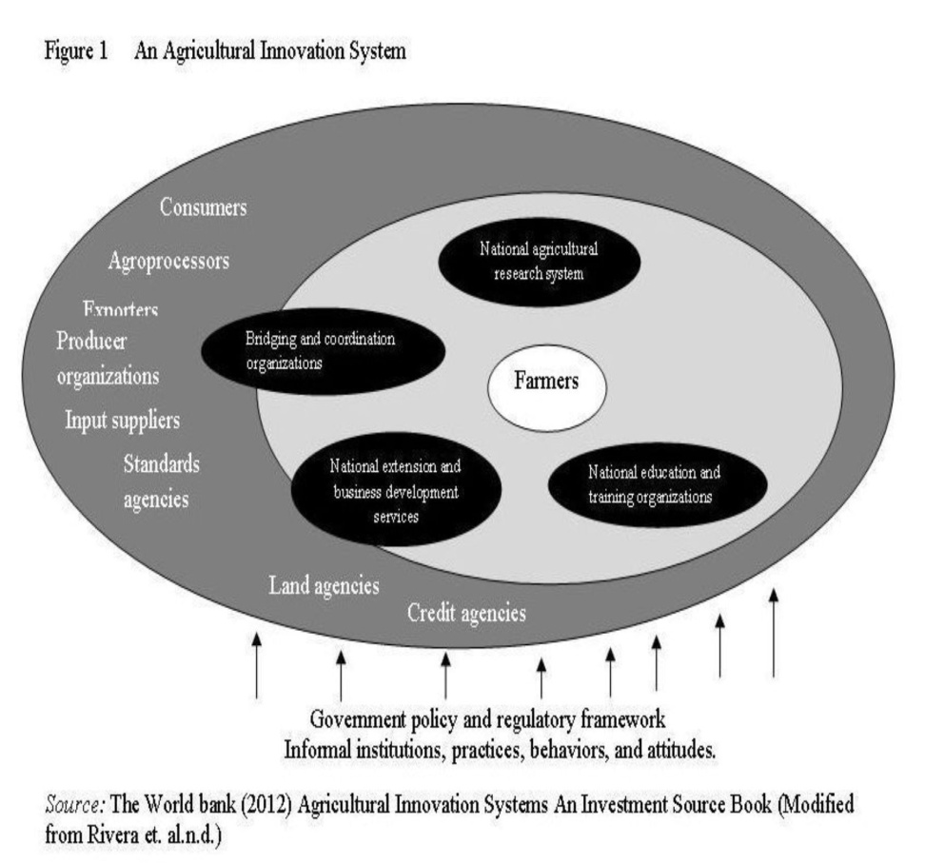
What we currently know of Innovation?
Innovation
the process by which
new knowledge is generated, adapted and used
How innovation happens? through interaction among actors in the AIS
AIS
interactive network of
organisations,
enterprises and
individuals together with institutions and policies

Slide 9
Other things we know of innovation
It is not a two stage process
It requires interactions among a wide range of actors and this process needs facilitation
Institutional and policy changes are often needed for innovation to happen
It involves a wide range of functions and tools performed by several agencies that work through platforms and partnerships

Slide 10
RAS and Innovation
Role of RAS – Facilitate Innovation
  Traditional Roles
    Mainly Public sector: Disseminating information (technology/prices/services) technology demonstration, training, forming user groups, farmer field schools,
    - Others: (wherever they operate) Problem solving advice, facilitation, link inputs and outputs, Business Development Services, Social mobilisation,

Slide 11
New Additional Roles
    Development of networks,
    Building capacities of other RAS providers
    Organising producers and assist in accessing services
    (credit, inputs and output services)
    Mediating conflicts (improving dialogue/reach agreement),
    Advocacy for policy changes
    Convening innovation platforms
    Old roles have value only when it is bundled together with these new roles
    Every organisation need not necessarily have to play all these roles

Slide 12
New Capacities at different levels
1. Individual
Technical
Knowledge on new technologies/practices/
Standards/Regulations
2. Functional
Community mobilisation
Farmer organisation development,
Coaching,
Mediation
Leadership
Problem solving
Partnership building
Reflective learning
Brokering
Generalists and Specialists
All these won’t be found in one single individual/ organisation and so partnering
Targeting capacity development to nature of the task

Slide 13
New Capacities at different levels
2. Organisational
Institutions that enable sharing, interacting, learning
Strategic Management Functions
Structures & Relationships,
Processes, Systems and procedures
Values. Incentives/Rewards
Human and Financial Resource
Infrastructure

Slide 14
New Capacities at different levels
3. Enabling Environment
Macro economic policies, incentives to increase production
Political commitment to agricultural development
Availability of policy framework
Capacity of policy making bodies to adapt policies based on learning
Capacity and willingness of other actors to share resources and engage in joint action
Institutions that facilitate collaboration
Availability and access to inputs

Slide 15
Supporting capacity development
Capacity development is a long term investment and change process
Strengthening technical capacities would remain important. But should be supplemented with efforts at building more effective and dynamic relationships between different actors
Build on existing capacities
Several approaches
  Establishment and strengthening of training centres
  Establishment of Agricultural Advisory Services
  Demand side strengthening
  Action learning
  Action learning in Innovation Platforms
  Documentation and development of new frameworks
  Networking and Policy Advocacy

Slide 16
I. Recommended Actions: National level
Diagnosis of the AIS with specific focus on RAS
Undertake survey (institutional analysis) of RAS providers in the country
Undertake capacity self-diagnosis of RAS
Create mechanisms for regular monitoring, reflection, learning and evaluation; review of systems & processes; create arrangements for co-ordination and collaborative action among RAS.
Create innovation platforms and initiate pilot projects to experiment with new approaches and learning from these

Slide 17
I. Recommended Actions: National level
Establish and strengthen training centres; Contracting specific competencies required for supporting capacity development; Encourage management training centres and business schools to organise tailor made capacity development programmes for RAS on coaching, facilitation, leadership, vision building.
Develop curriculum for vocational and continuing education and skill up-gradation of individuals
Support establishment of national network of RAS providers
Initiate policy research on RAS and AIS to support evidence based reforms and policy advocacy
Enhance public funding for RAS

Slide 18
II. Recommended Actions: Regional Levels
Support establishment of Regional & Sub-regional Networks and engage them in design, implementation and evaluation of RAS interventions
Collect and synthesise evidence on different aspects of RAS in the region
Develop policy briefs and position papers to influence policy process to support RAS
Develop and promote new frameworks and methodologies related to RAS
Organise regional consultations and training programmes to share experiences and influence conditions in the enabling

Slide 19
III. Recommended Actions: Global Level
Support GFRAS and other international actors to lead and guide networking and capacity development and policy advocacy for RAS at the global level
Strengthen, support and co-ordinate regional networks of RAS to achieve their respective goals
Develop frameworks, tools, training modules, investment source books, discussion papers to shape the evolution of RAS and share these outputs widely

Slide 20
III. Recommended Actions: Global Level
Liaise with donors at the global and regional levels engaged in RAS
Policy advocacy on strengthening the role of RAS in agricultural development and poverty reduction and advocating for enhanced funding support and institutional and policy reforms in AIS
Promote inter-regional sharing of experiences with reforms and new approaches in RAS
Provide long term financial and technical support to RAS to manage change and develop new capacities; Use new investments to experiment with new approaches and promote institutional reforms

Slide 21
Conclusions: AIS and RAS
AIS builds on the new understanding of the innovation process
It offers a new framework to reinvent RAS in this increasingly complex and pluralistic context (set of principles and not a blueprint)
RAS can and should play an important role in enabling innovation.
Analysis of the innovation process through AIS framework reveals the wider set of functions RAS have to perform
“The New Extensionist” – attempt to articulate these new areas and potential ways of developing new capacities.
Capacity development should focus at the three levels and efforts are required at the national, regional and global levels.

Slide 22
Thanks

